Slide 1
Network Flow
网络流
Max flow-Min Cut
最大流最小割定理

Slide 2
Outline
Network flow 网络流
Flows and Cuts 流和割
Residual Graph 残差图
Augmenting Paths 增广路径
Ford Fulkerson Algorithm 福特-福克森算法
Max flow-Min Cut Theorem 最大流最小割
Application – Bipartite Matching

Slide 3
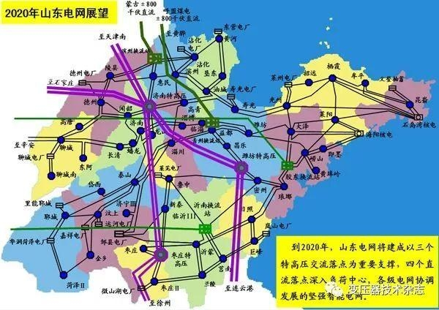
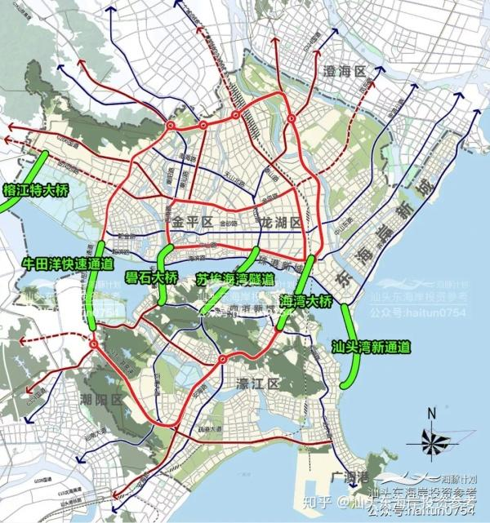
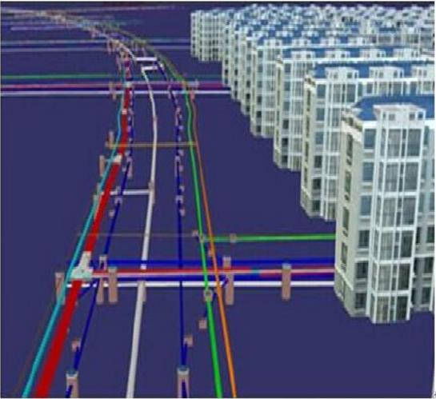
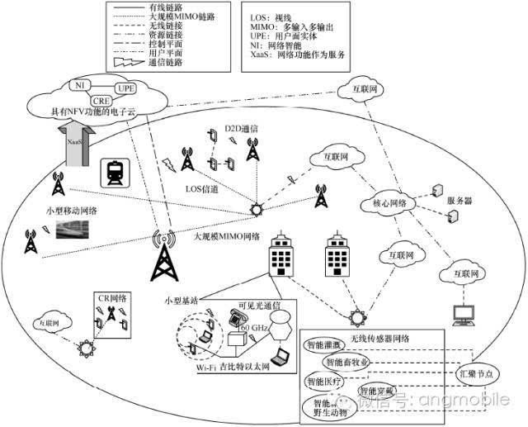
Network Flow

Slide 4
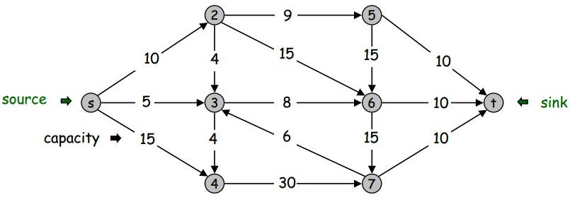
Network Flow Definitions
Flowgraph: Directed graph with distinguished vertices s (source源点) and t (sink收点/汇点)
Capacities（容量） on the edges: c(e) >= 0
边上标注的是容量值

Slide 5
Multiple Sources or Sinks
What if you have a problem with more than one source and more than one sink?
Modify the graph to create a single supersource and supersink
13
a
13
b
15
a
b
13
15
13
10
t
i
10
9
5
k
s
4
9
5
4
∞
∞
14
11
3
14
c
11
d
3
c
d
t
s
4
4
13
e
13
f
15
e
f
13
15
13
∞
∞
10
y
j
10
9
5
l
x
4
9
5
4
14
11
3
14
g
11
h
3
g
h

Slide 6
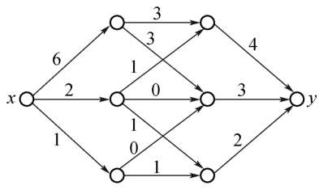
Network Flow
Problem, assign flows f(e) to the edges such that:
  0 <= f(e) <= c(e) （容量约束）
  Flow is conserved at vertices other than s and t
    Flow conservation: flow going into a vertex equals the flow going out （守恒约束）
  优化目标 ：The flow leaving the source is as large as possible
    Denoted by |f|
一个可行流，边上标注的是流量

Slide 7
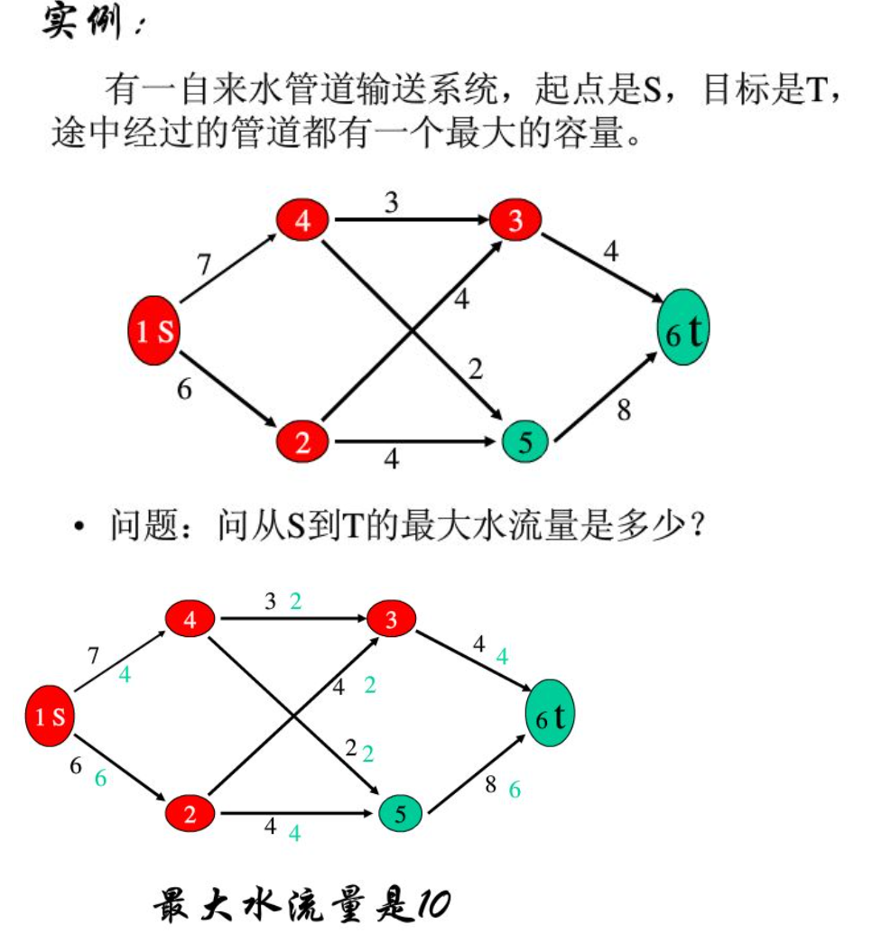
Network Flow

Slide 8



Flows
Def. An s-t flow （可行流）is a function that satisfies:
  For each e ∈ E: [capacity]
  For each v ∈ V – {s, t}: [conservation]
  特例：零流
Def. The value of a flow f is:
0
2
9
5
边上灰色标注的是流量，黑色标注的是容量
4
0
0
10
4
4
15
15
0
10
0
4
4
s
5
3
8
6
10
t
0
0
capacity
4
0
6
15
0
10
15
flow
0
0
Value = 4
4
30
7

Slide 9
Flows
Def. An s-t flow is a function that satisfies:
  For each e ∈ E: [capacity]
  For each v ∈ V – {s, t}: [conservation]
Def. The value of a flow f is:
6
2
9
5
10
0
6
10
4
4
15
15
0
10
3
8
8
s
5
3
8
6
10
t
1
10
capacity
4
0
6
15
0
10
15
flow
11
11
Value = 24
4
30
7

Slide 10
Maximum Flow Problem
Max flow problem. Find s-t flow of maximum value.
所有可行流中，流量最大的流的流量
9
2
9
5
10
1
9
10
4
0
15
15
0
10
4
8
9
s
5
3
8
6
10
t
4
10
capacity
4
0
6
15
0
10
15
flow
14
14
Value = 28
4
30
7

Slide 11
Cuts in a graph
Cut: Partition of V into disjoint sets S, T with s in S and t in T.
Cap(S,T): sum of the capacities of edges from S to T
Flow(S,T): net flow out of S
  Sum of flows out of S minus sum of flows into S
Flow(S,T) <= Cap(S,T)

Slide 12
What is Cap(S,T) and Flow(S,T)
S={s, a, b, e, h}, T = {c, f, i, d, g, t}
20/20
20/20
a
d
g
0/5
0/5
20/20
20/20
5/5
0/5
0/5
5/5
0/20
s
25/30
b
20/20
e
h
30/30
t
20/20
0/5
5/5
20/20
0/5
0/10
15/20
15/25
c
f
i
20/20
10/10

Slide 13
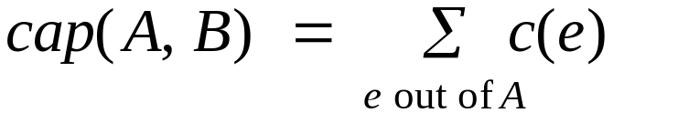
Cuts
Def. An s-t cut is a partition (A, B) of V with s ∈ A and t ∈ B.
Def. The capacity of a cut (A, B) is:
2
9
5
10
4
15
15
10
s
5
3
8
6
10
t
A
4
6
15
10
15
Capacity = 10 + 5 + 15
= 30
4
30
7

Slide 14
Cuts
Def. An s-t cut is a partition (A, B) of V with s ∈ A and t ∈ B.
Def. The capacity of a cut (A, B) is:
2
9
5
10
4
15
15
10
s
5
3
8
6
10
t
A
4
15
15
6
10
Capacity = 9 + 15 + 8 + 30
= 62
4
30
7

Slide 15
Minimum Cut Problem
Min s-t cut problem. Find an s-t cut of minimum capacity.
2
9
5
10
4
15
15
10
s
5
3
8
6
10
t
A
4
6
15
10
15
Capacity = 10 + 8 + 10
= 28
4
30
7

Slide 16

Flows and Cuts
Flow value lemma. Let f be any flow, and let (A, B) be any s-t cut. Then, the net flow sent across the cut is equal to the amount leaving s.
6
2
9
5
10
0
6
10
4
4
15
15
0
10
3
8
8
s
5
3
8
6
10
t
A
1
10
4
0
6
15
0
10
15
11
11
Value = 10+3+11=24
4
30
7

Slide 17
Flows and Cuts
Flow value lemma. Let f be any flow, and let (A, B) be any s-t cut. Then, the net flow sent across the cut is equal to the amount leaving s.
6
2
9
5
10
0
6
10
4
4
15
15
0
10
3
8
8
s
5
3
8
6
10
t
A
1
10
4
0
6
15
0
10
15
11
11
Value = 6 + 0 + 8 - 1 + 11
= 24
4
30
7

Slide 18
Flows and Cuts
Flow value lemma. Let f be any flow, and let (A, B) be any s-t cut. Then, the net flow sent across the cut is equal to the amount leaving s.
6
2
9
5
10
0
6
10
4
4
15
15
0
10
3
8
8
s
5
3
8
6
10
t
A
1
10
4
0
6
15
0
10
15
11
11
Value = 10 - 4 + 8 - 0 + 10
= 24
4
30
7

Slide 19

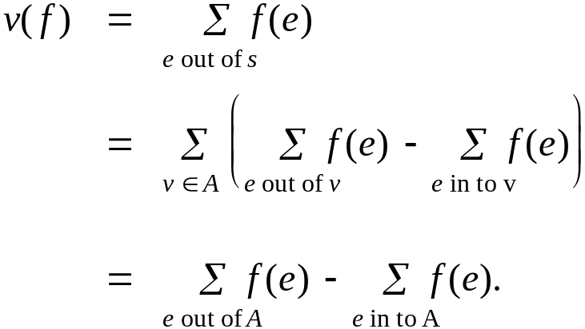
Flows and Cuts
Flow value lemma. Let f be any flow, and let (A, B) be any s-t cut. Then
Pf.
by flow conservation, all terms
except v = s are 0

Slide 20
Flows and Cuts
Weak duality. Let f be any flow, and let (A, B) be any s-t cut. Then the value of the flow is at most the capacity of the cut.
Cut capacity = 30 ⇒ Flow value ≤ 30
2
9
5
10
4
15
15
10
s
5
3
8
6
10
t
A
4
6
15
10
15
Capacity = 30
4
30
7

Slide 21
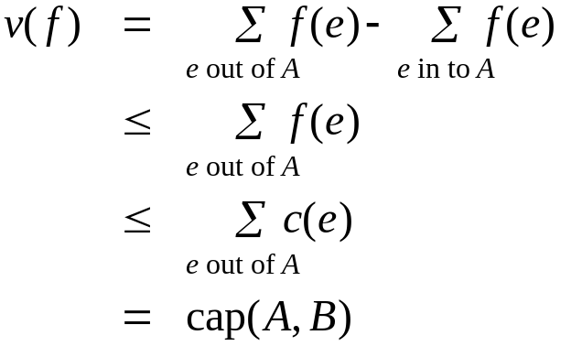
Flows and Cuts
Weak duality. Let f be any flow. Then, for any s-t cut (A, B) we have
v(f) ≤ cap(A, B).
Pf.
▪
A
B
4
8
t
s
7
6

Slide 22
Certificate of Optimality
Corollary. Let f be any flow, and let (A, B) be any cut.
If v(f) = cap(A, B), then f is a max flow and (A, B) is a min cut.
Value of flow = 28
Cut capacity = 28 ⇒ Flow value ≤ 28
9
2
9
5
10
1
9
10
4
0
15
15
0
10
4
8
9
s
5
3
8
6
10
t
4
10
A
4
0
6
15
0
10
15
14
14
4
30
7

Slide 23
Towards a Max Flow Algorithm
Greedy algorithm.
  Start with f(e) = 0 for all edge e ∈ E.
  Find an s-t path P where each edge has f(e) < c(e).
  Augment flow along path P.
  Repeat until you get stuck.
1
0
0
20
10
s
30
0
t
10
20
0
0
Flow value = 0
2

Slide 24
Towards a Max Flow Algorithm
Greedy algorithm.
  Start with f(e) = 0 for all edge e ∈ E.
  Find an s-t path P where each edge has f(e) < c(e).
  Augment flow along path P.
  Repeat until you get stuck.
1
20
0
0
X
20
10
30
0
20
t
s
X
10
20
0
0
20
Flow value = 20
X
2

Slide 25
Towards a Max Flow Algorithm
Greedy algorithm.
  Start with f(e) = 0 for all edge e ∈ E.
  Find an s-t path P where each edge has f(e) < c(e).
  Augment flow along path P.
  Repeat until you get stuck.
locally optimality ⇒ global optimality
1
1
20
0
20
10
20
10
20
10
s
30
20
t
s
30
10
t
10
20
10
20
0
20
10
20
greedy = 20
2
opt = 30
2

Slide 26
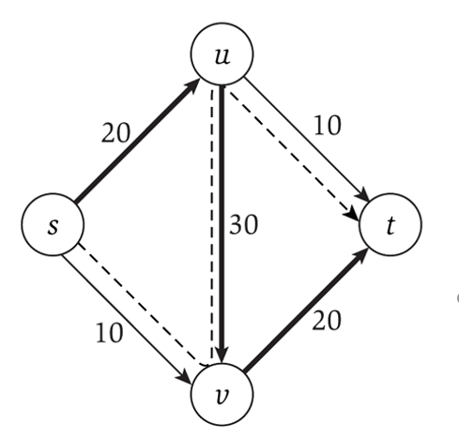
观察虚线：利用逆向边。
1
1
20
0
20
10
20
10
20
10
s
30
20
t
s
30
10
t
10
20
10
20
0
20
10
20
greedy = 20
2
opt = 30
2

Slide 27
Residual Graph（残差图）
Flow graph showing the remaining capacity
Flow graph G, Residual Graph G_{R}
  G: edge e from u to v with capacity c and flow f
  G_{R}: edge e’ from u to v with capacity c – f
  G_{R}: edge e’’ from v to u with capacity f

Slide 28
The residual graph
u
5
10
15
s
15
15
t
5
5
20
v
the residual graph

Slide 29
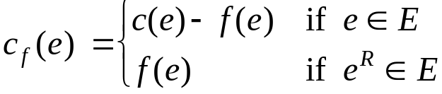
Residual Graph
Original edge: e = (u, v) ∈ E.
  Flow f(e), capacity c(e).
Residual edge.
  "Undo" flow sent.
  e = (u, v) and e^{R} = (v, u).
  Residual capacity:
Residual graph: G_{f} = (V, E_{f} ).
  Residual edges with positive residual capacity.
  E_{f} = {e : f(e) < c(e)} ∪ {e^{R} : f(e) > 0}.
capacity
u
17
v
6
flow
residual capacity
u
11
v
6
residual capacity

Slide 30
Augmenting Path Algorithm
Augmenting path（增广路径）
  Vertices v₁,v₂,…,v_{k}
    v₁ = s, v_{k} = t
    Possible to add b units of flow between v_{j} and v_{j+1} for j = 1 … k-1
u
10/20
0/10
s
10/30
t
5/10
15/20
v

Slide 31
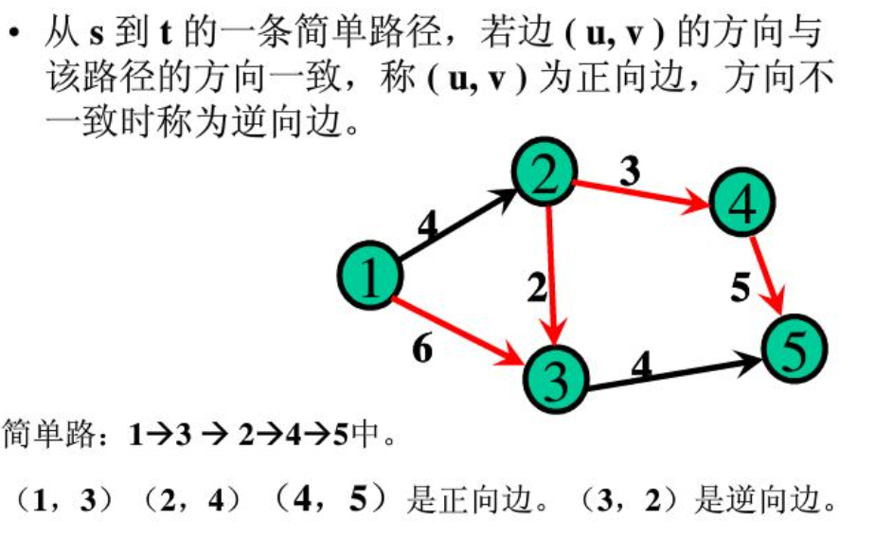
Augmenting Path Algorithm

Slide 32
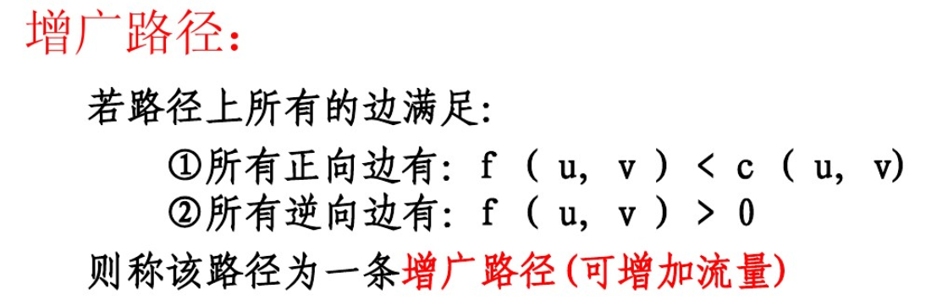
Augmenting Path Algorithm
Augment(f, c, P) {
b ← bottleneck(P)
foreach e ∈ P {
if (e ∈ E) f(e) ← f(e) + b
else f(e^{R})← f(e^{R}) - b
}
return f
}
b > 0
forward edge
reverse edge
找到这样一条路径，其流量未达到容量上限。增广后，总流量增加了b。

Slide 33
Ford-Fulkerson Algorithm (1956)
Ford-Fulkerson(G, s, t, c) {
foreach e ∈ E f(e) ← 0
G_{f} ← residual graph
while (there exists augmenting path P) {
f ← Augment(f, c, P)
update G_{f}
}
return f
}
先假定容量为非负整数：
If the sum of the capacities of edges leaving S is at most C, then the algorithm takes at most C iterations.（每次都增加，但总量有限，一定会结束）

Slide 34
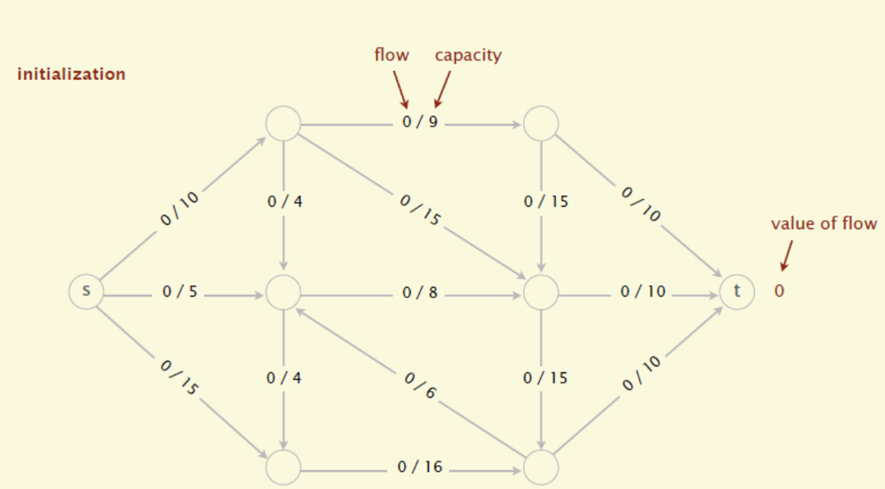
Ford-Fulkerson Algorithm (1956)

Slide 35
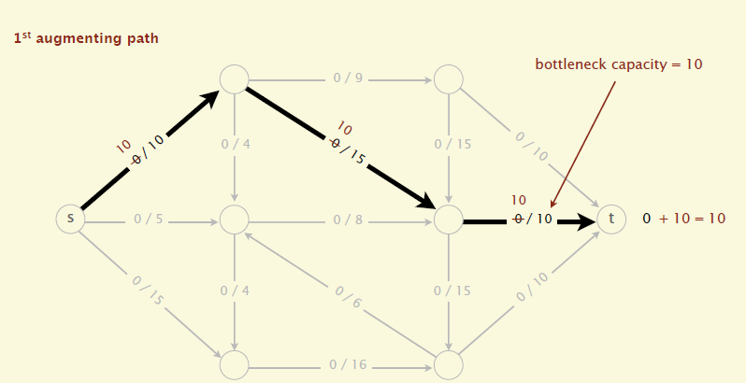
Ford-Fulkerson Algorithm (1956)

Slide 36
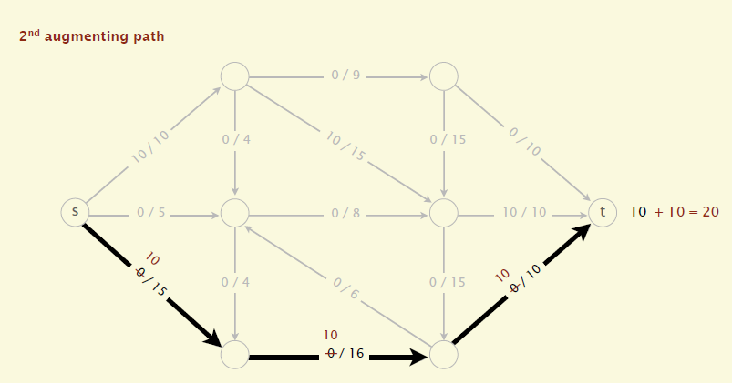
Ford-Fulkerson Algorithm (1956)

Slide 37
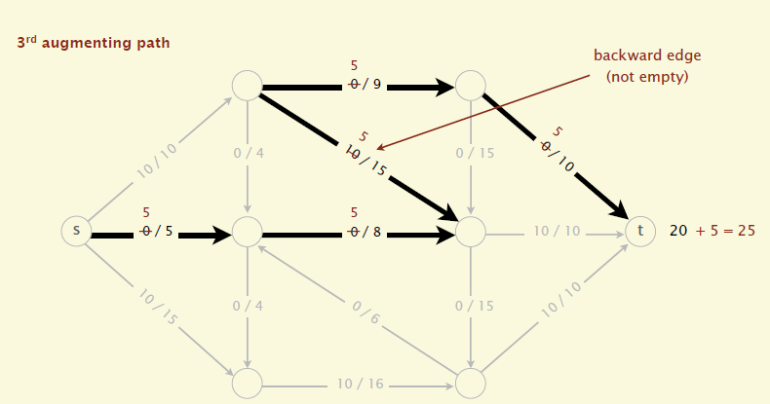
Ford-Fulkerson Algorithm (1956)

Slide 38
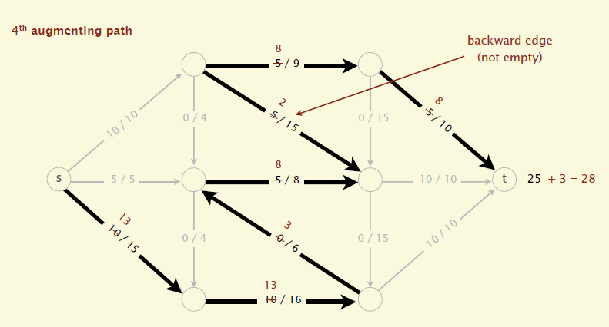
Ford-Fulkerson Algorithm (1956)

Slide 39
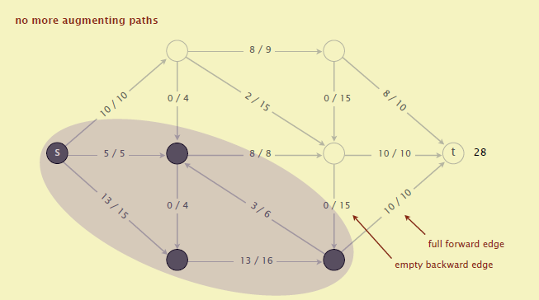
Ford-Fulkerson Algorithm (1956)

Slide 40
Max-Flow Min-Cut Theorem
Augmenting path theorem. Flow f is a max flow iff there are no augmenting paths.
Max-flow min-cut theorem. [Elias-Feinstein-Shannon 1956, Ford-Fulkerson 1956] The value of the max flow is equal to the value of the min cut.
(There exists a flow which has the same value of the minimum cut)
Pf. We prove both simultaneously by showing TFAE (the following are equivalent):
  (i) There exists a cut (A, B) such that v(f) = cap(A, B).
  存在一个割的容量等于flow f的值
  (ii) Flow f is a max flow.
  f是最大流
  (iii) There is no augmenting path relative to f.
  对于f没有增广路径

Slide 41
Max-Flow Min-Cut Theorem
(i) ⇒ (ii) This was the corollary to weak duality lemma.
假设我们有一个割（A,B）的容量等于f的值，那么所有流的值<=(A,B)的容量，从而（2）成立
(ii) ⇒ (iii) We show contrapositive.
  Let f be a flow. If there exists an augmenting path, then we can improve f by sending flow along path.
  我们来证明它的逆否命题。对于f如果还有还有增广路径，那f不是最大流。这很显然。如果按照FF算法的话，我们还可以增加flow f的值，因此f就不会是最大流，因此逆否命题成立，也就代表（2）->(3)成立。

Slide 42
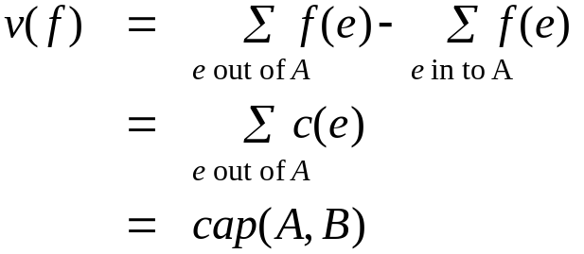
Proof of Max-Flow Min-Cut Theorem
(iii) ⇒ (i)
  Let f be a flow with no augmenting paths.
  Let A be set of vertices reachable from s in residual graph.
    通过这些边可达：要么是不是满的前向边，要么是非空的反向边。
  By definition of A, s ∈ A.
  By definition of f, t ∉ A. （因为没有增广路径）
A
B
t
Explained next page
s
original network

Slide 43
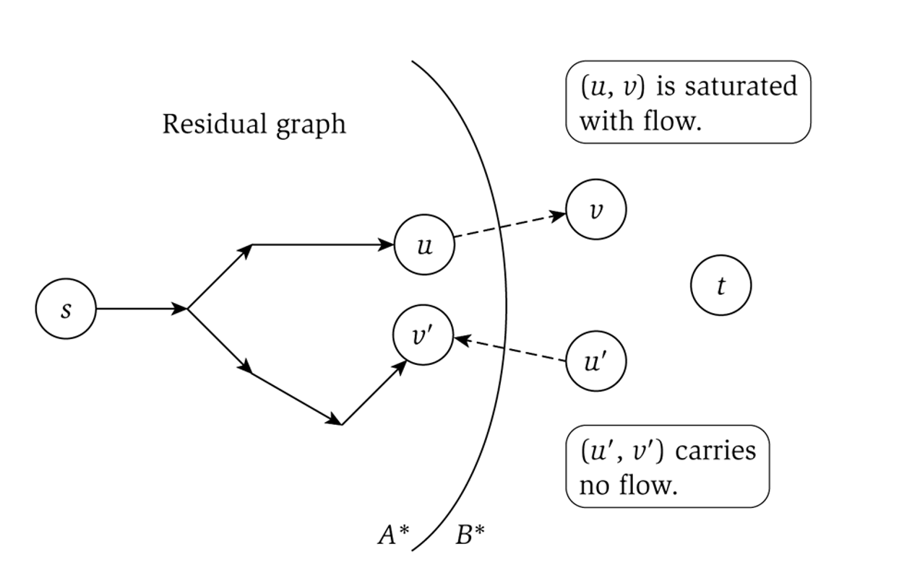
Proof of Max-Flow Min-Cut Theorem

Slide 44
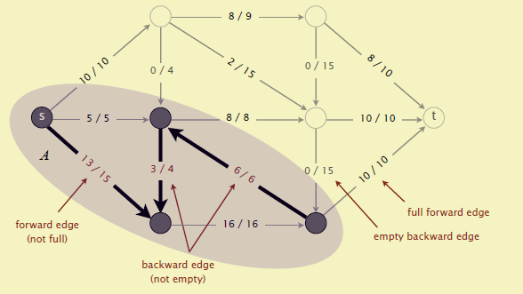
Proof of Max-Flow Min-Cut Theorem

Slide 45
Max Flow - Min Cut Theorem
Ford-Fulkerson algorithm finds a flow where the residual graph is disconnected, hence FF finds a maximum flow.
If we want to find a minimum cut, we begin by looking for a maximum flow.

Slide 46
Performance
The worst case performance of the Ford-Fulkerson algorithm is horrible
u
1000
1000
s
1
t
1000
1000
v

Slide 47
Ford-Fulkerson: Exponential Number of Augmentations
Q. Is generic Ford-Fulkerson algorithm polynomial in input size?
A. No. If max capacity is C, then algorithm can take C iterations.
m, n, and log C
1
1
1
0
0
1
0
0
X
X
X
1
C
C
C
C
1
0
t
1
0
1
0
t
s
X
1
s
X
X
C
C
C
C
0
0
1
0
0
1
X
1
X
X
2
2

Slide 48
Running Time
Assumption. All capacities are integers between 1 and C.
Invariant. Every flow value f(e) and every residual capacity c_{f} (e) remains an integer throughout the algorithm.
Theorem. The algorithm terminates in at most v(f*) ≤ nC iterations.
Pf. Each augmentation increase value by at least 1. ▪
Corollary. If C = 1, Ford-Fulkerson runs in O(mn) time.
Integrality theorem. If all capacities are integers, then there exists a max flow f for which every flow value f(e) is an integer.
Pf. Since algorithm terminates, theorem follows from invariant. ▪

Slide 49
Choosing Good Augmenting Paths
Use care when selecting augmenting paths.
  Some choices lead to exponential algorithms.
  Clever choices lead to polynomial algorithms.
  If capacities are irrational, algorithm not guaranteed to terminate!
Goal: choose augmenting paths so that:
  Can find augmenting paths efficiently.
  Few iterations.
Choose augmenting paths with: [Edmonds-Karp 1972, Dinitz 1970]
  Max bottleneck capacity.
  Sufficiently large bottleneck capacity.
  Fewest number of edges.

Slide 50
Capacity Scaling
Intuition. Choosing path with highest bottleneck capacity increases flow by max possible amount.
  Don't worry about finding exact highest bottleneck path.
  Maintain scaling parameter Δ.
  Let G_{f} (Δ) be the subgraph of the residual graph consisting of only arcs with capacity at least Δ.
4
4
110
102
110
102
s
1
t
s
t
122
170
122
170
2
2
G_{f}
G_{f} (100)

Slide 51
Capacity Scaling
Scaling-Max-Flow(G, s, t, c) {
foreach e ∈ E f(e) ← 0
Δ ← smallest power of 2 greater than or equal to C
G_{f} ← residual graph
while (Δ ≥ 1) {
G_{f}(Δ) ← Δ-residual graph
while (there exists augmenting path P in G_{f}(Δ)) {
f ← augment(f, c, P)
update G_{f}(Δ)
}
Δ ← Δ / 2
}
return f
}

Slide 52
Capacity Scaling: Correctness
Assumption. All edge capacities are integers between 1 and C.
Integrality invariant. All flow and residual capacity values are integral.
Correctness. If the algorithm terminates, then f is a max flow.
Pf.
  By integrality invariant, when Δ = 1 ⇒ G_{f}(Δ) = G_{f}.
  Upon termination of Δ = 1 phase, there are no augmenting paths. ▪
  Theorem. The scaling max-flow algorithm finds a max flow in O(m log C) augmentations. It can be implemented to run in O(m² log C) time. ▪

Slide 53
Performance of finding augmenting paths
Find the maximum capacity augmenting path
  O(m²log(C)) time algorithm for network flow
Find the shortest augmenting path
  O(m²n) time algorithm for network flow
Find a blocking flow in the residual graph
  O(mnlog n) time algorithm for network flow

Slide 54
Application – Bipartite Matching
Example – given a community with n men and m women
Assume we have a way to determine which couples (man/woman) are compatible for marriage
  E.g. (Joe, Susan) or (Fred, Susan) but not (Frank, Susan)
Problem: Maximize the number of marriages
  No polygamy allowed
  Can solve this problem by creating a flow network out of a bipartite graph

Slide 55
Bipartite Graph
A bipartite graph is an undirected graph G=(V,E) in which V can be partitioned into two sets V₁ and V₂ such that (u,v) ∈ E implies either u ∈ V₁ and v ∈ V₁₂ or vice versa.
That is, all edges go between the two sets V₁ and V₂ and not within V₁ and V₂.

Slide 56
Model for Matching Problem
Men on leftmost set, women on rightmost set, edges if they are compatible
A
A
X
A
X
X
B
B
B
Y
Y
Y
C
C
C
Z
Z
D
Z
D
D
Men
Women
A matching
Optimal matching

Slide 57
Solution Using Max Flow
Add a supersouce, supersink, make each undirected edge directed with a flow of 1
A
A
X
X
B
B
t
Y
s
Y
C
C
Z
Z
D
D
Since the input is 1, flow conservation prevents multiple matchings

Slide 58
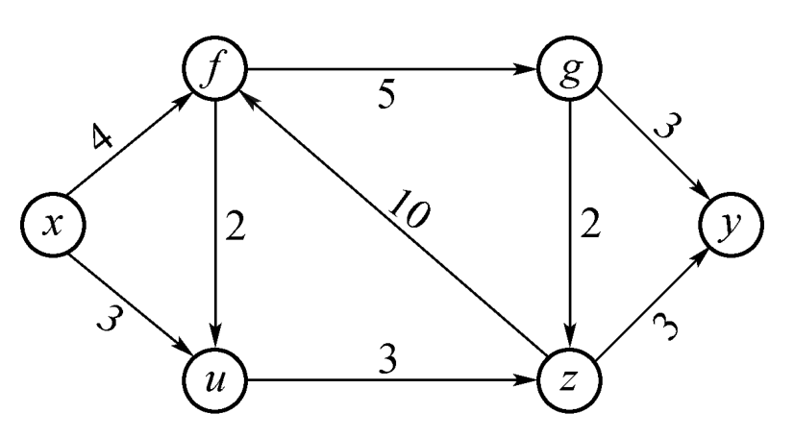
Homework
找出最大流，求出它的流量值，并证明它是最大流。（不用交)

